Slide 1
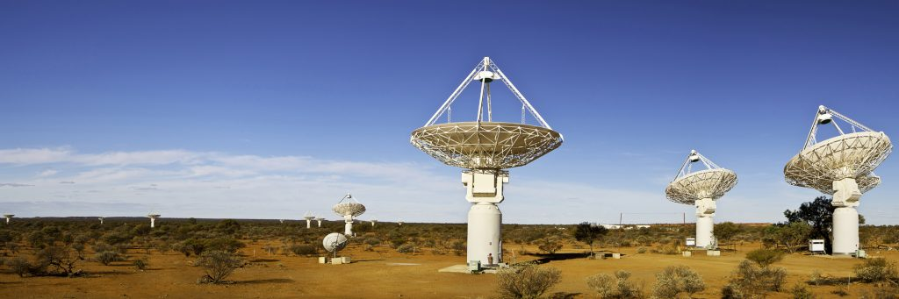
Basics of Radio Astronomy

Slide 2
Scientific Motivations
Why do we observe in the optical?

Slide 3
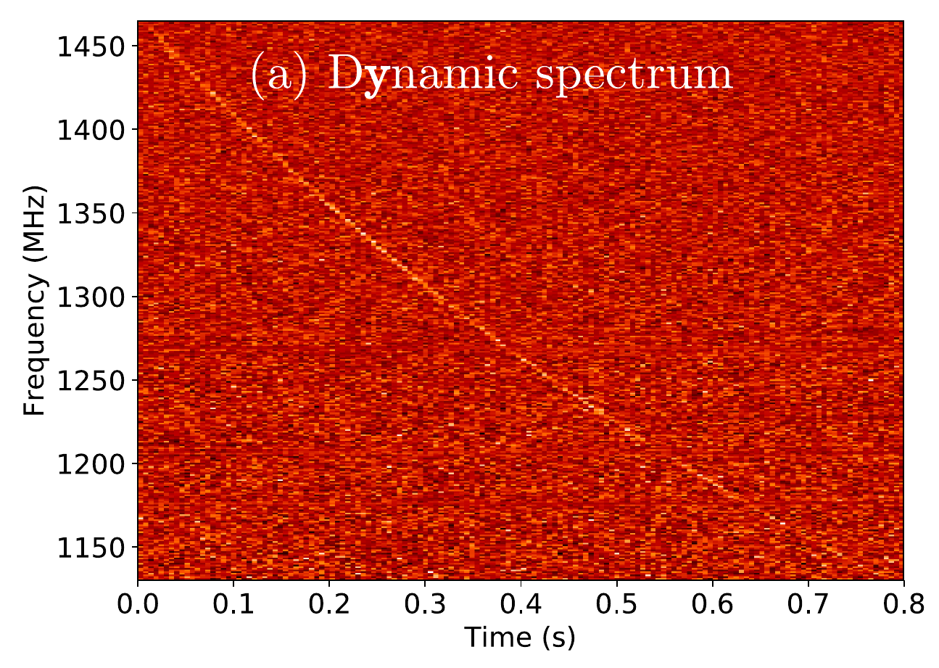
Scientific Motivations

Slide 4
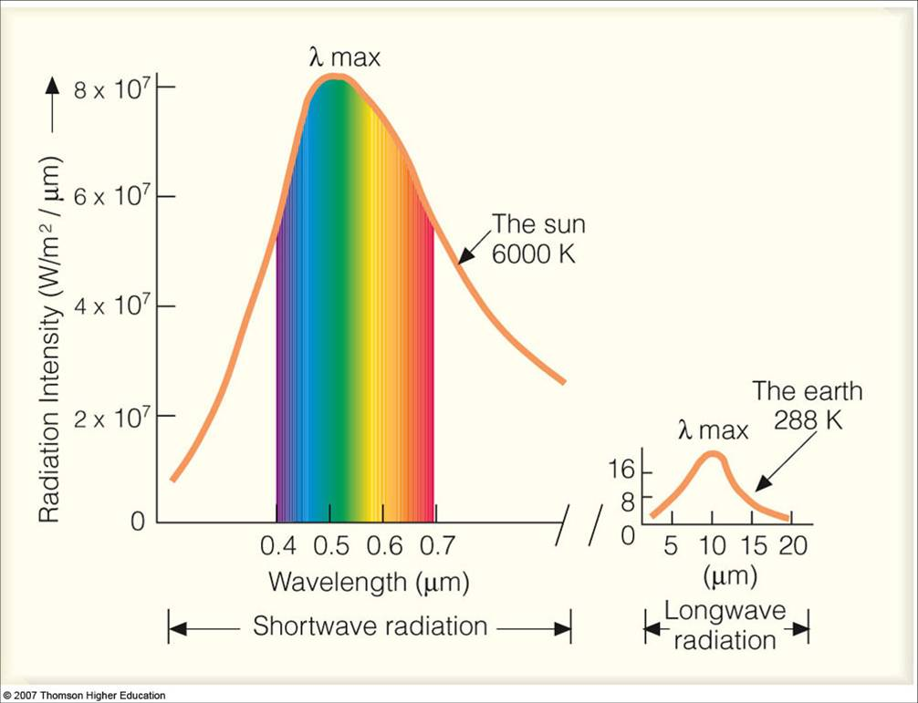
Scientific Motivations

Slide 5
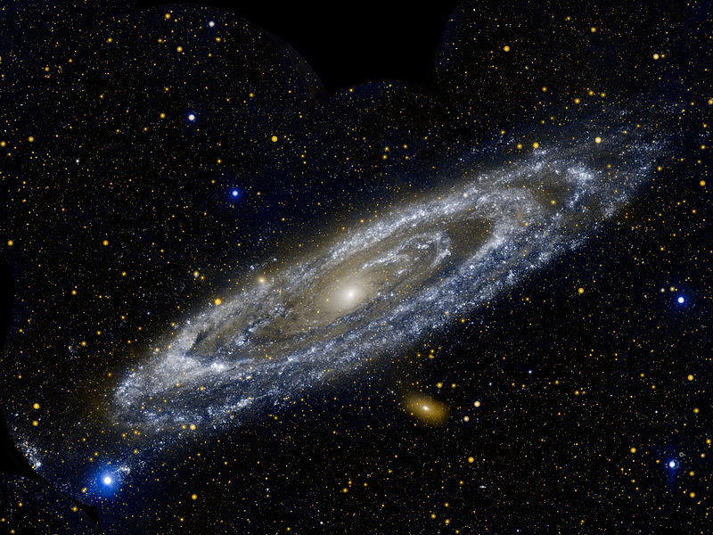
Scientific Motivations

Slide 6
Scientific Motivations
But are stars (and planets!) all that we have?

Slide 7
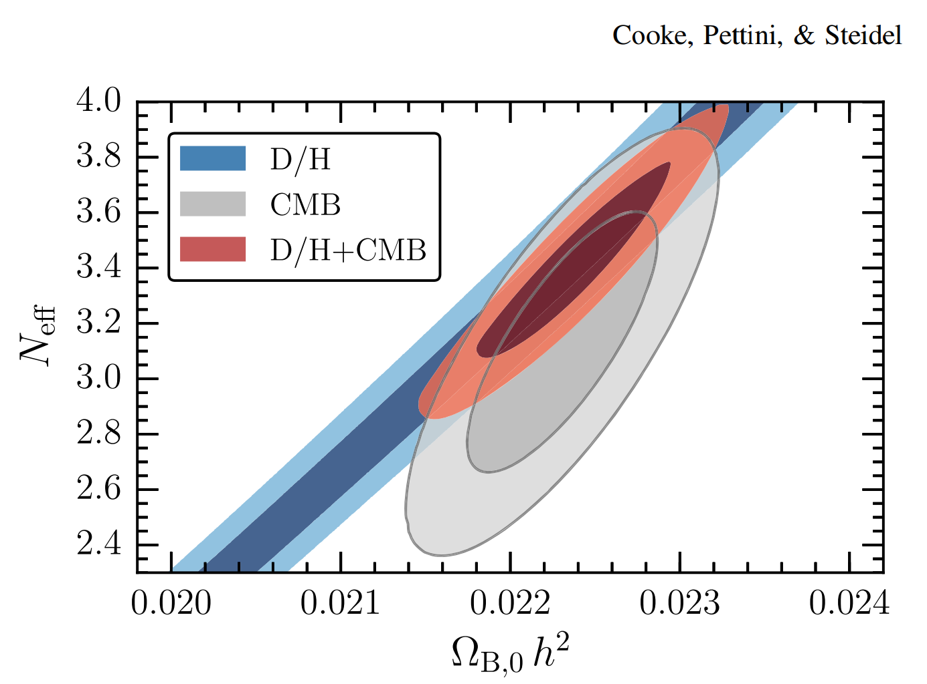
Counting the Cosmic Baryons: Consensus

Slide 8
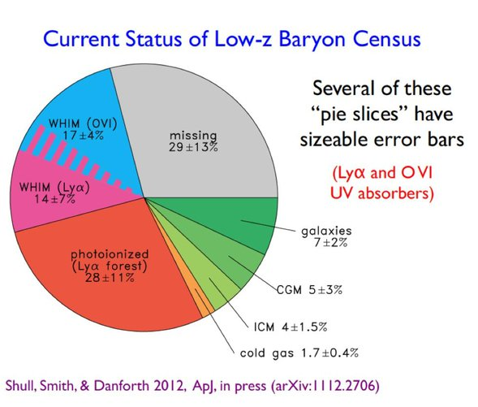
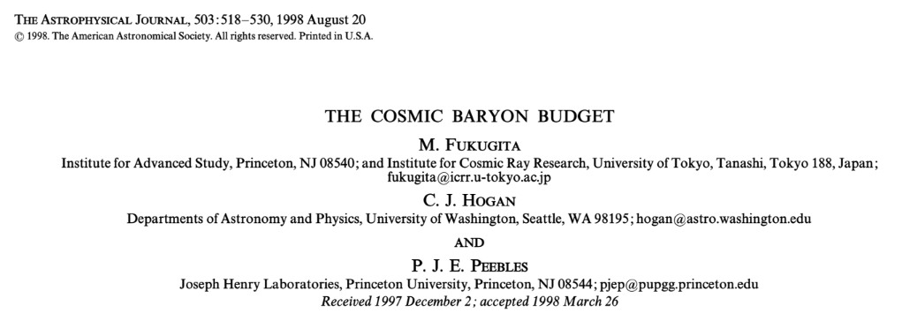
Scientific Motivations
Missing Baryons!!
(approximately half)

Slide 9
Scientific Motivations
How do we study dust and gas?!

Slide 10
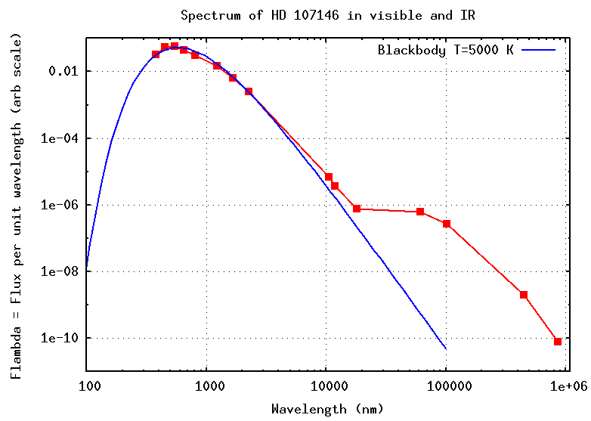
Scientific Motivations
(1mm)

Slide 11
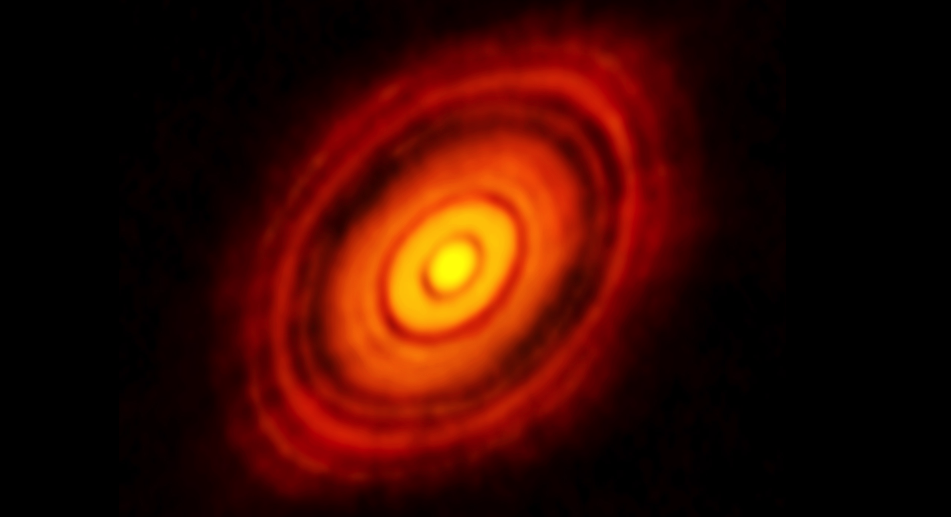
Scientific Motivations

Slide 12
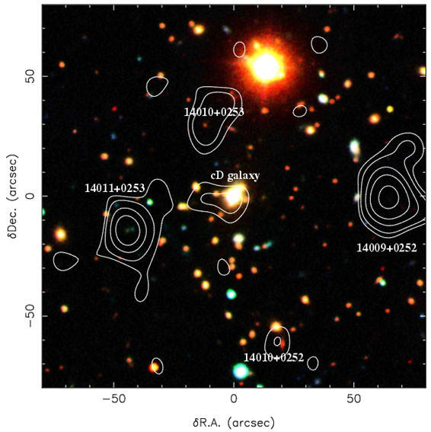
Scientific Motivations

Slide 13
Scientific Motivations
How do we study dust and gas?!

Slide 14
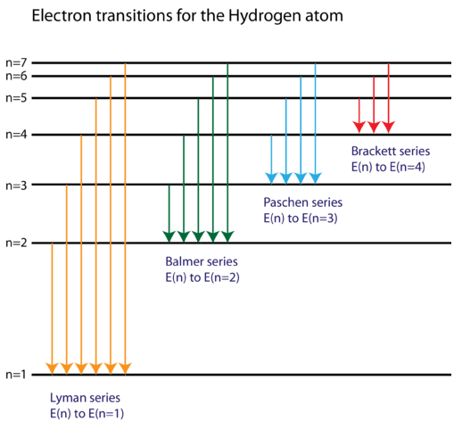
Scientific Motivations
Lyman ~ 10eV (1000A)
Balmer ~ 2 eV (5000A)
Paschen ~ 1 eV (1 micron)
Brackett ~ 0.5 eV (microns)
But, these are only useful for recombining gas, i.e. ionized gas!

Slide 15
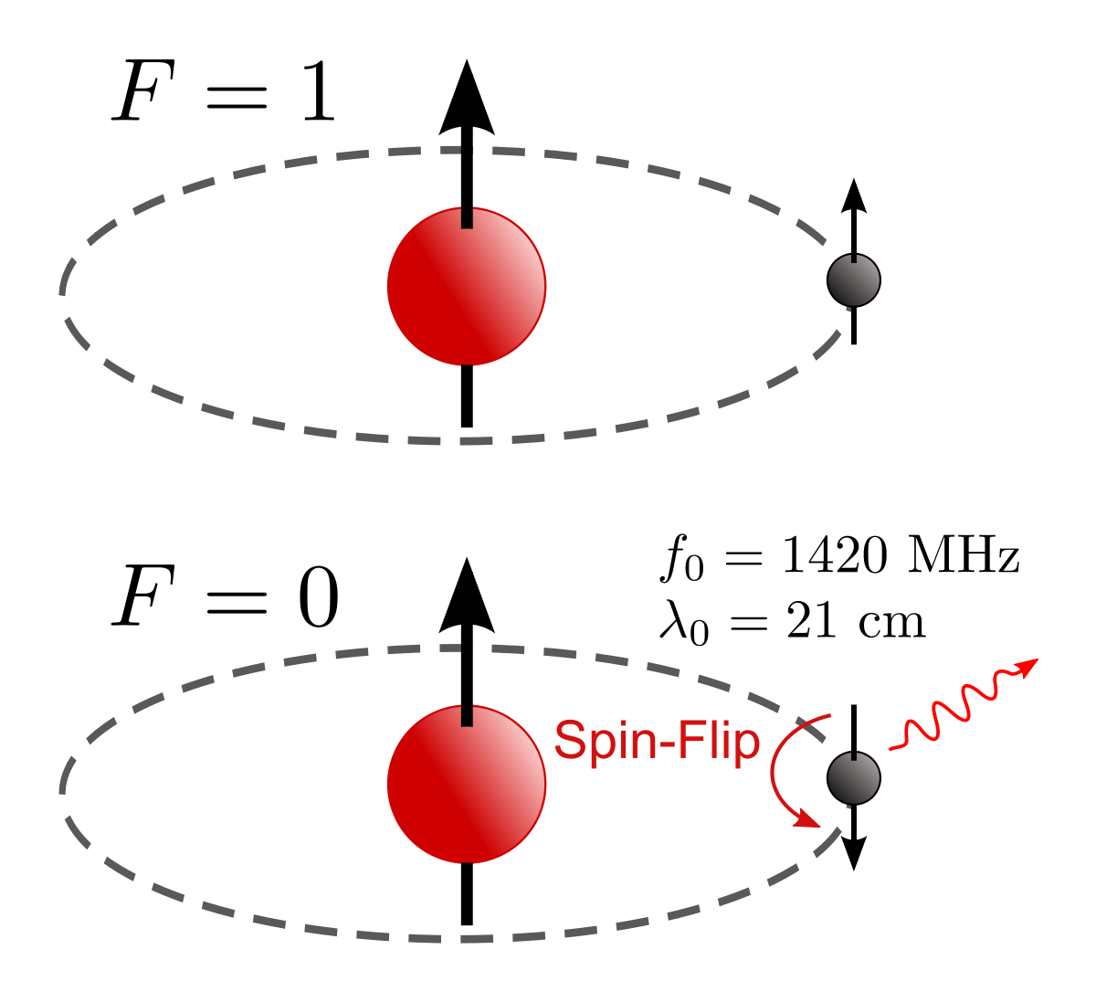
Scientific Motivations
Hydrogen
Atom

Slide 16
Scientific Motivations
J =5/2
J =3/2
1335.7 A
1334.5 A
J =3/2
[CII] 158 microns
J =1/2
158 microns

Slide 17
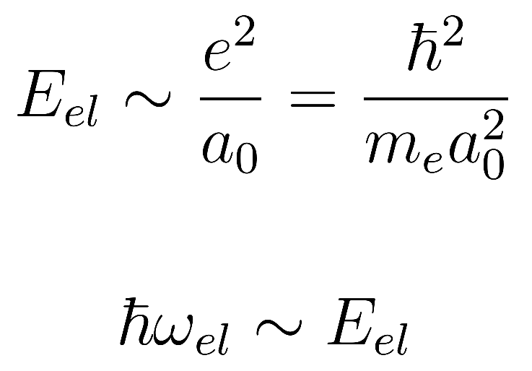
Scientific Motivations
Molecules -- Electronic
𝝀 ~1000 Å

Slide 18
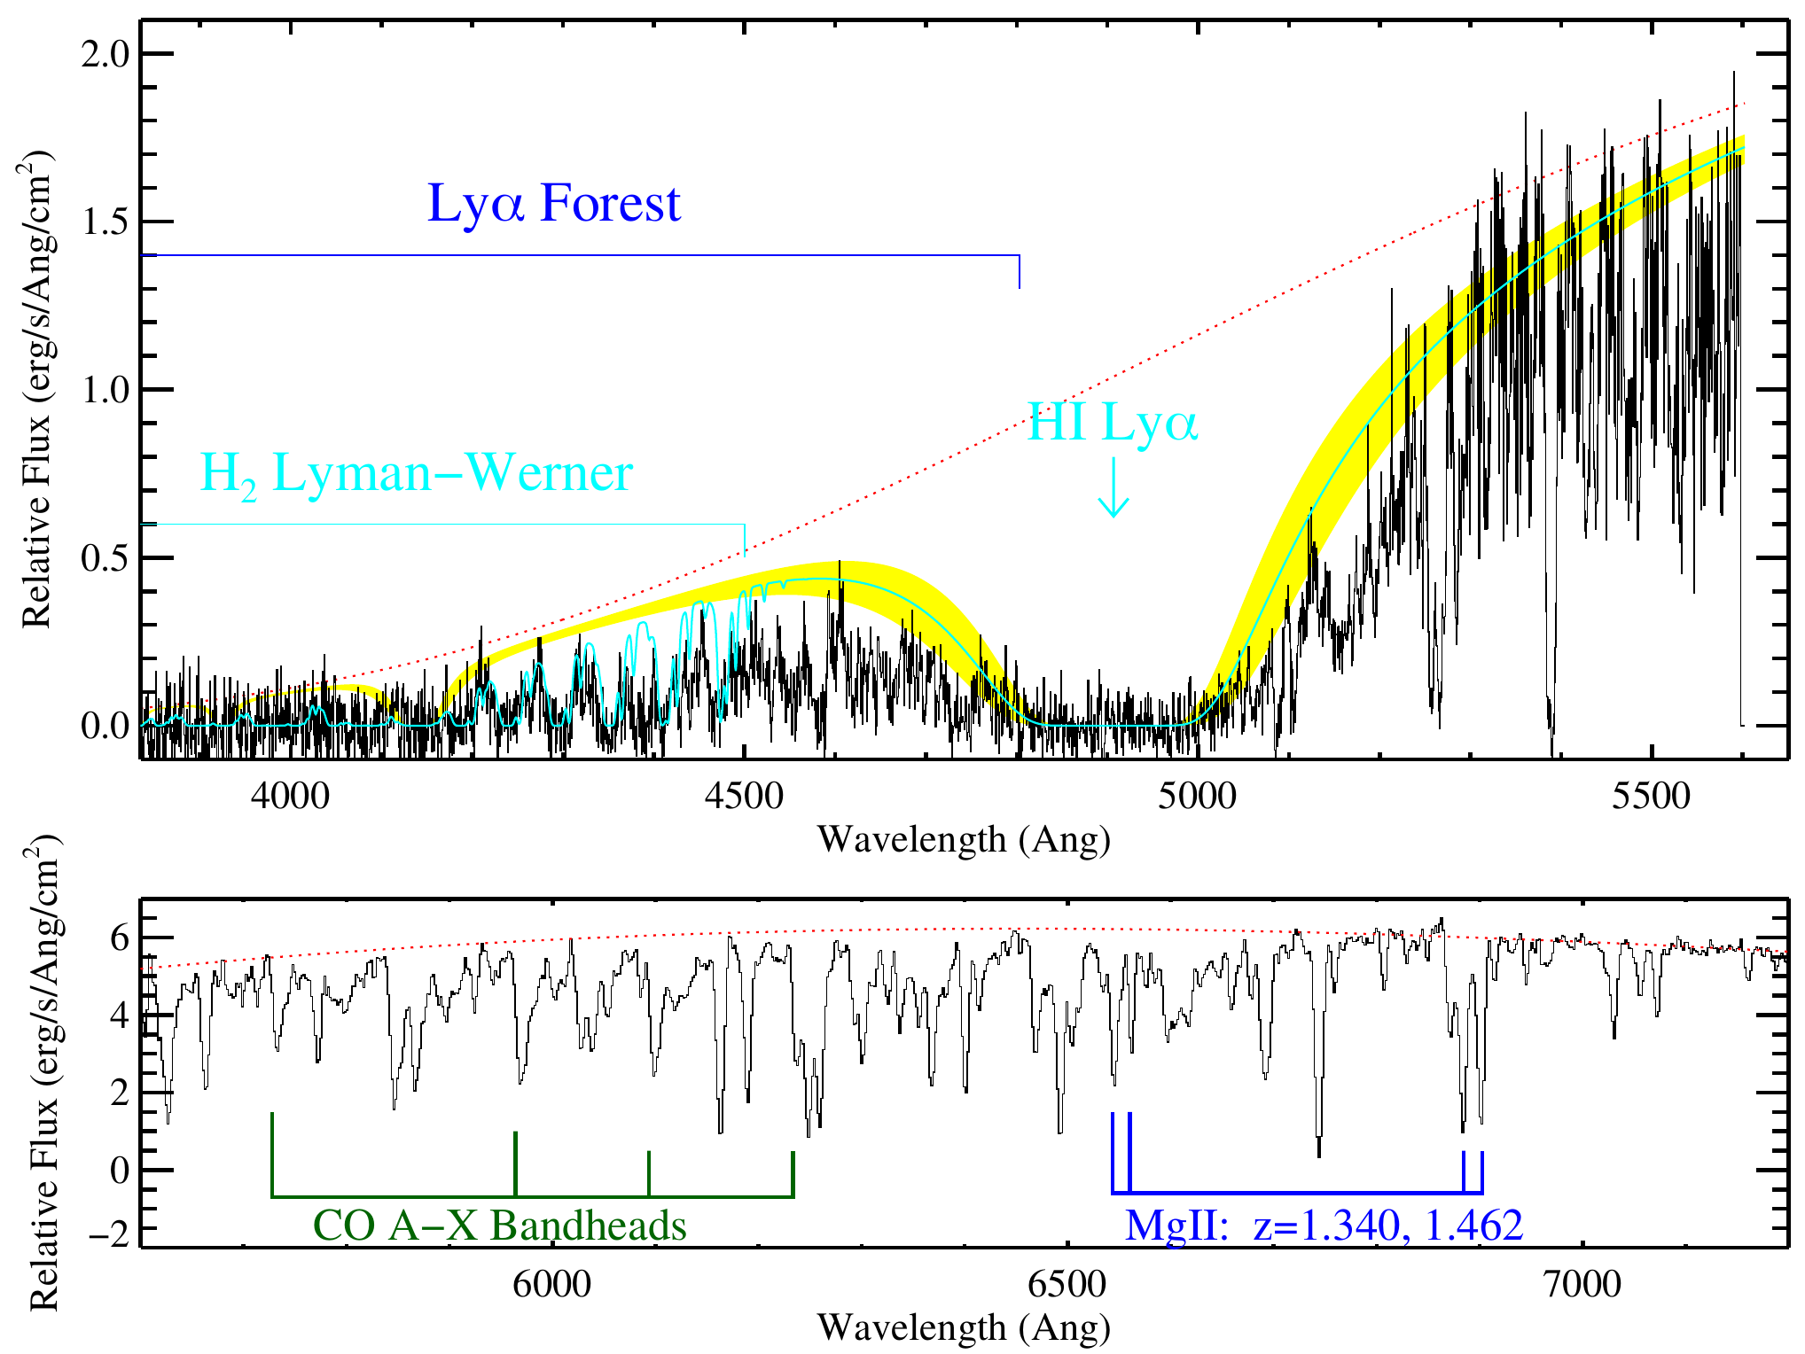
Molecules -- Electronic

Slide 19
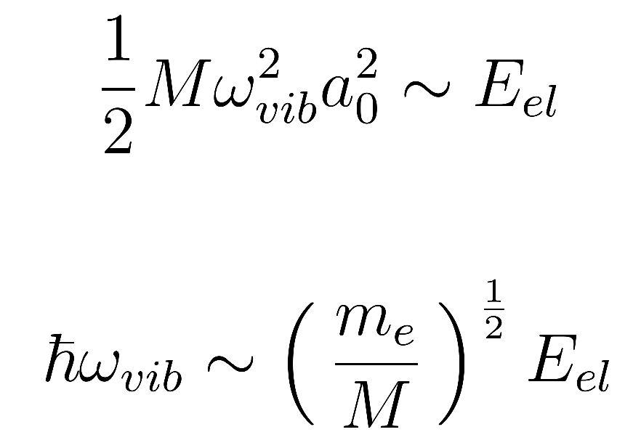
Scientific Motivations
Molecules -- Vibrational
𝝀 ~2 µm

Slide 20
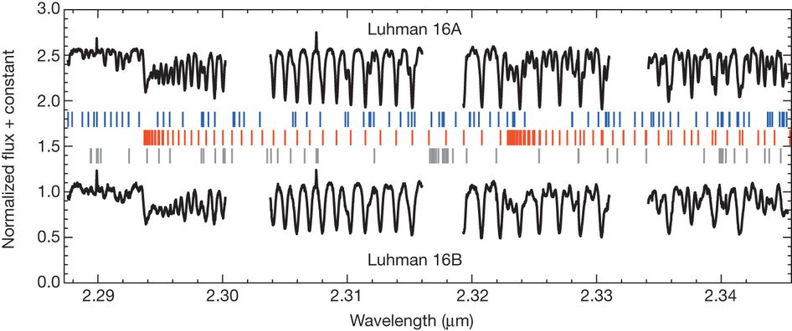
Molecules -- Vibrational
𝝀 ~ 2 µm

Slide 21
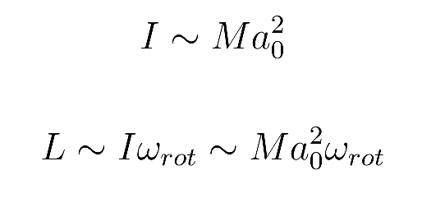
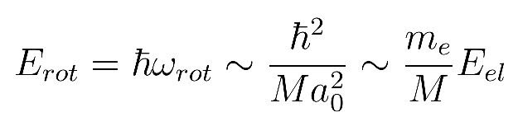
Scientific Motivations
Molecules -- Rotational
𝝀 ~2 mm

Slide 22
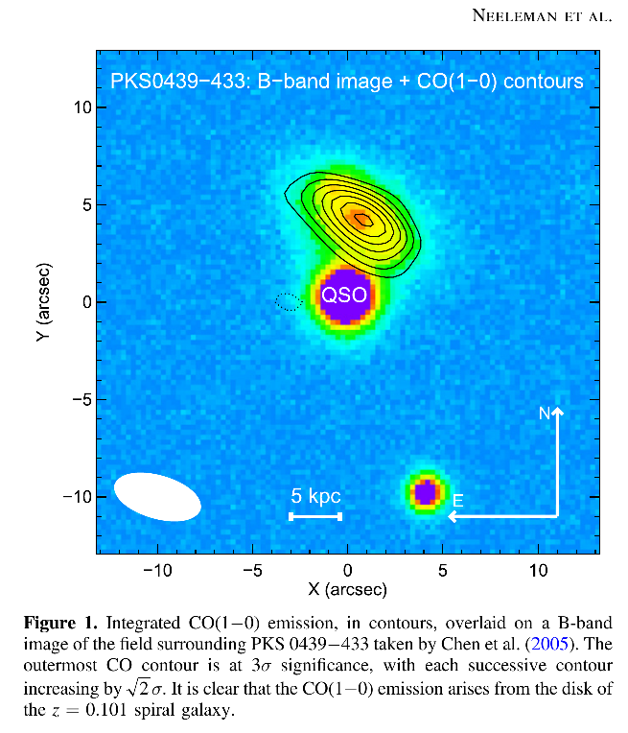
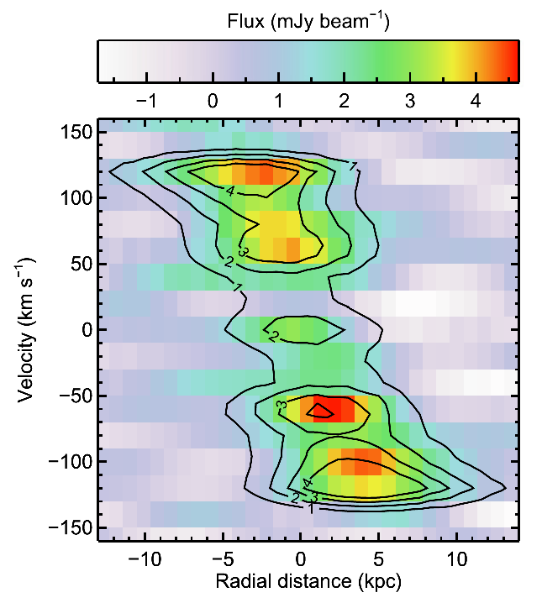
Molecules -- Rotational
𝝀 ~2 mm

Slide 23
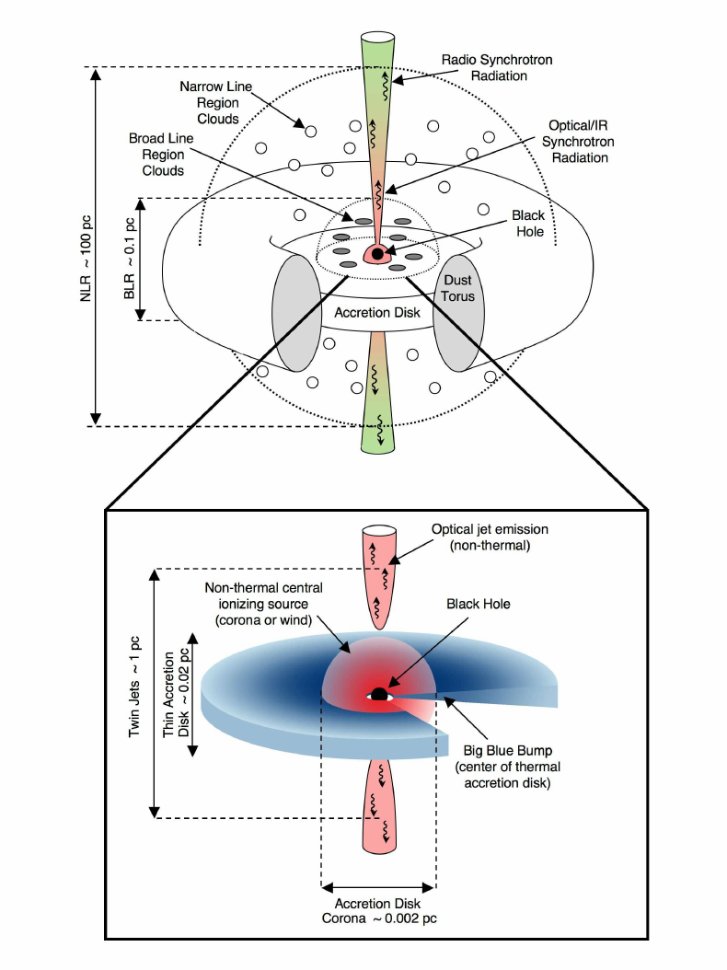
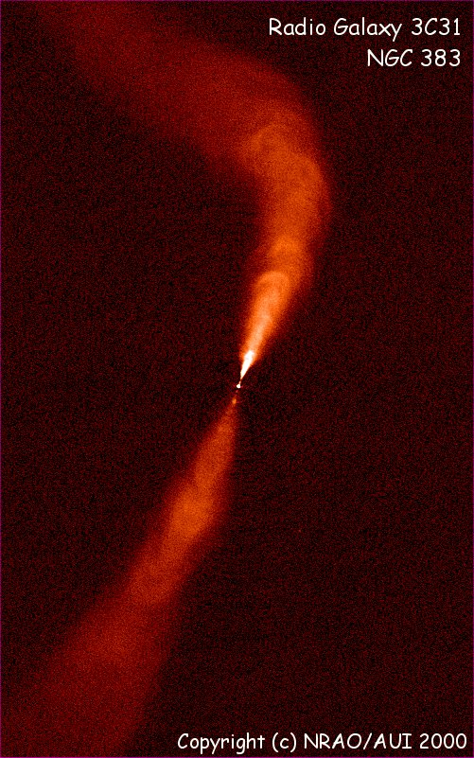
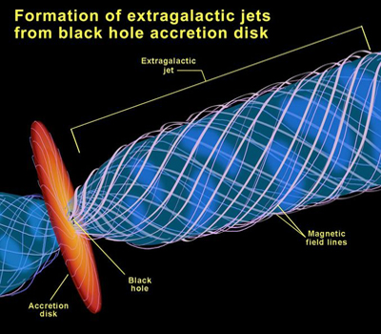
Scientific Motivations
Synchrotron

Slide 24
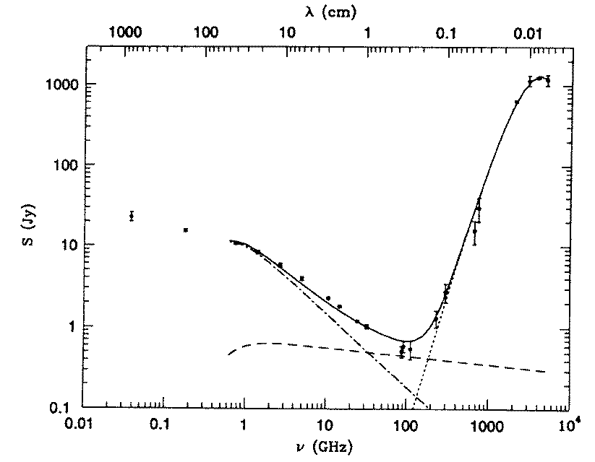
Scientific Motivations
Synchrotron

Slide 25
Observational Motivations

Slide 26
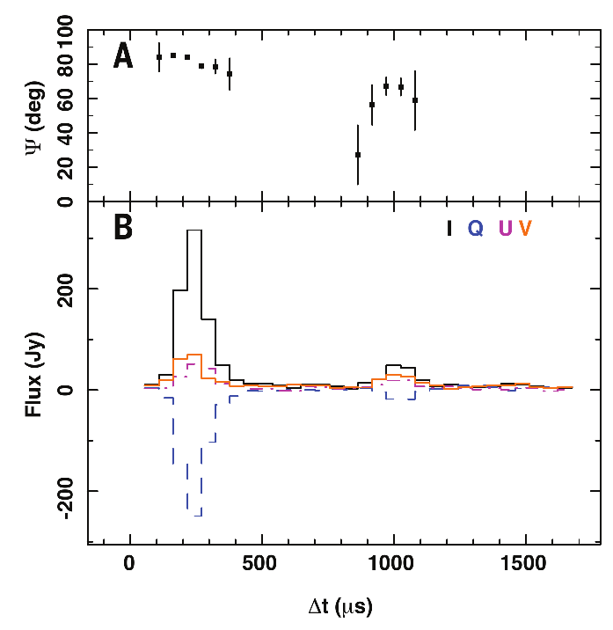
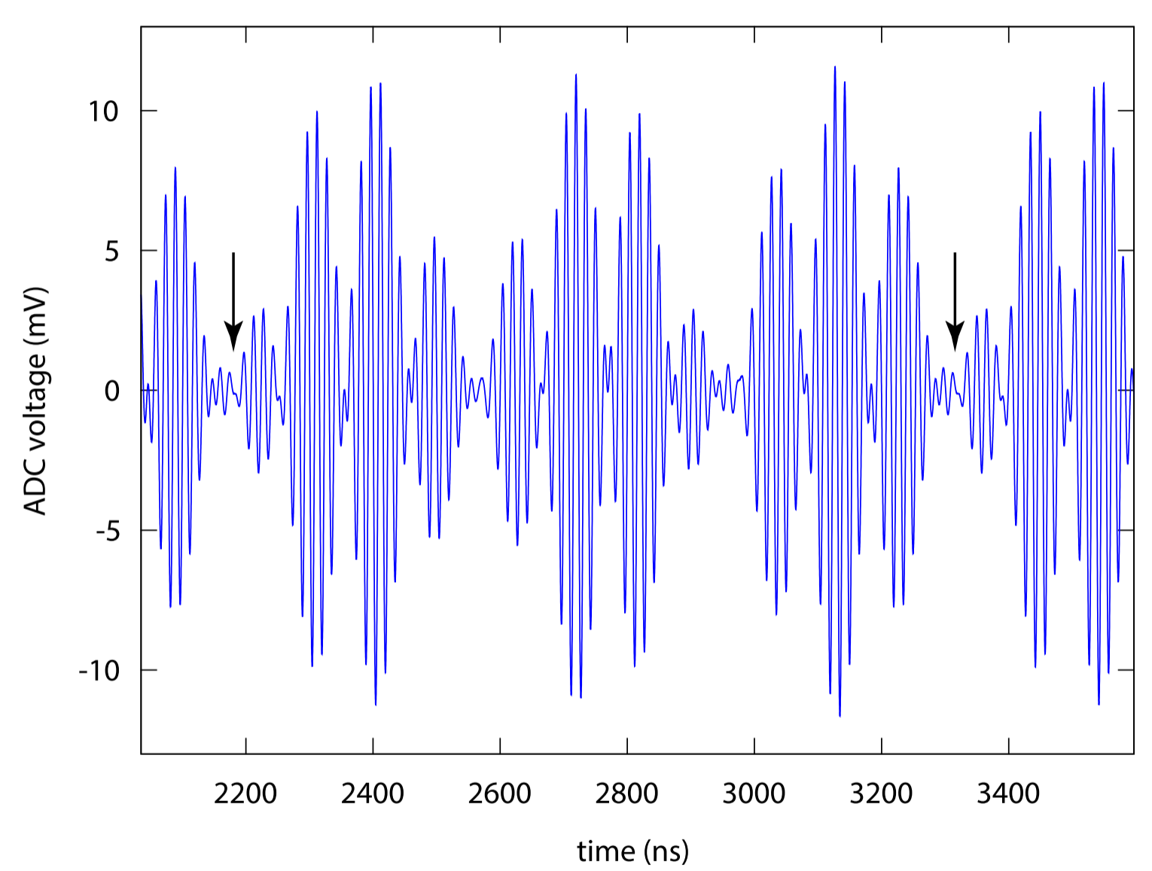
Observational Motivations
Timing
Pierre Auger

Slide 27
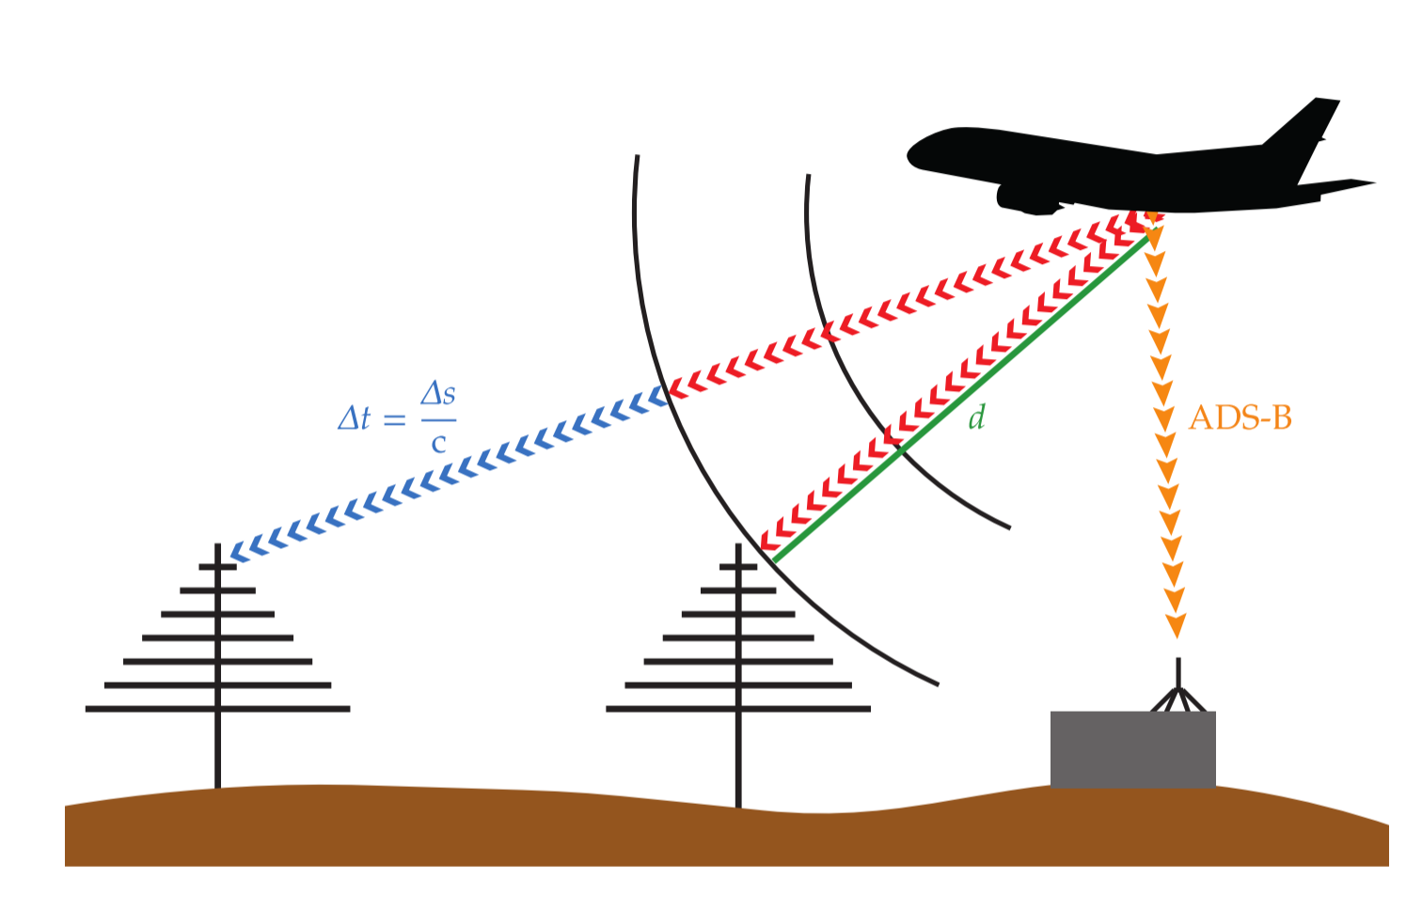
Observational Motivations
Timing
Pierre Auger

Slide 28
Observational Motivations
Spectral Resolution
d𝛎 = (Band/channels) = 5 Hz
𝛎 = 1 GHz
R = 𝛎/d𝛎
= 10⁸ !!!!

Slide 29

Observational Motivations
Spatial Resolution

Slide 30
Observational Motivations
Spatial Resolution
𝜭 = 𝝀 / D
D = 500 m
𝝀 = 21 cm
𝜭 = 1.5’

Slide 31
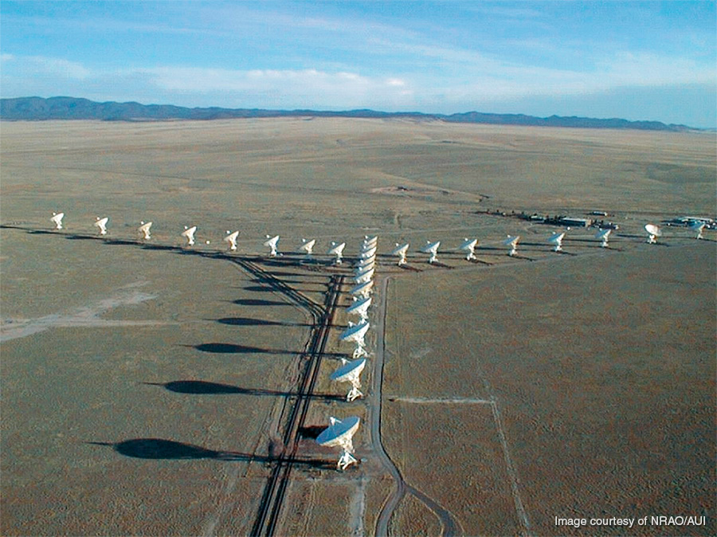
Observational Motivations
Spatial Resolution (now we’re cooking)

Slide 32
Observational Motivations
Spatial Resolution
𝜭 = 𝝀 / D
D = 40 km
𝝀 = 21 cm
𝜭 = 1’’

Slide 33
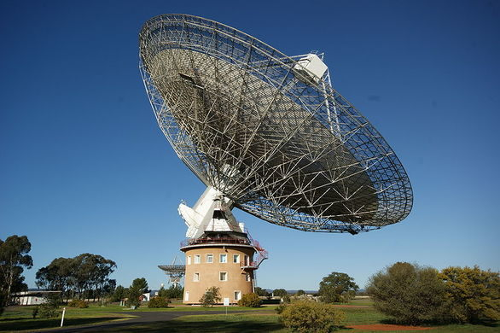
Collecting Radio Light

Slide 34
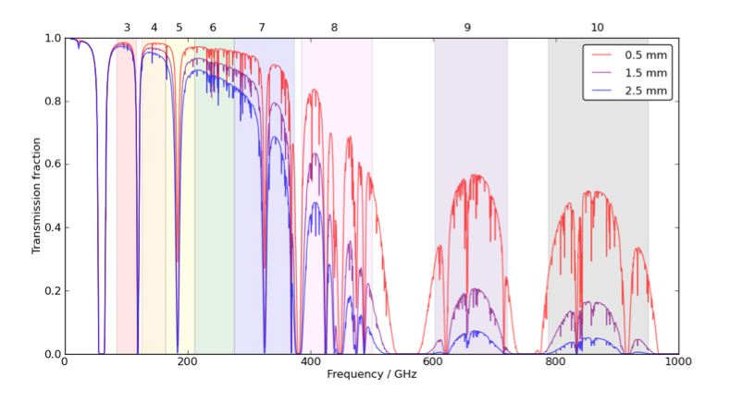
Collecting Radio Light
Sky Transmission (ALMA)

Slide 35
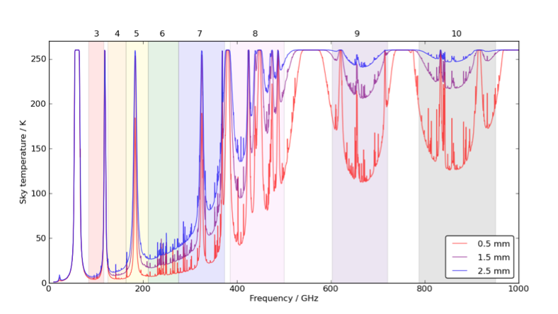
Collecting Radio Light
Sky Temperature (Noise; ALMA)

Slide 36
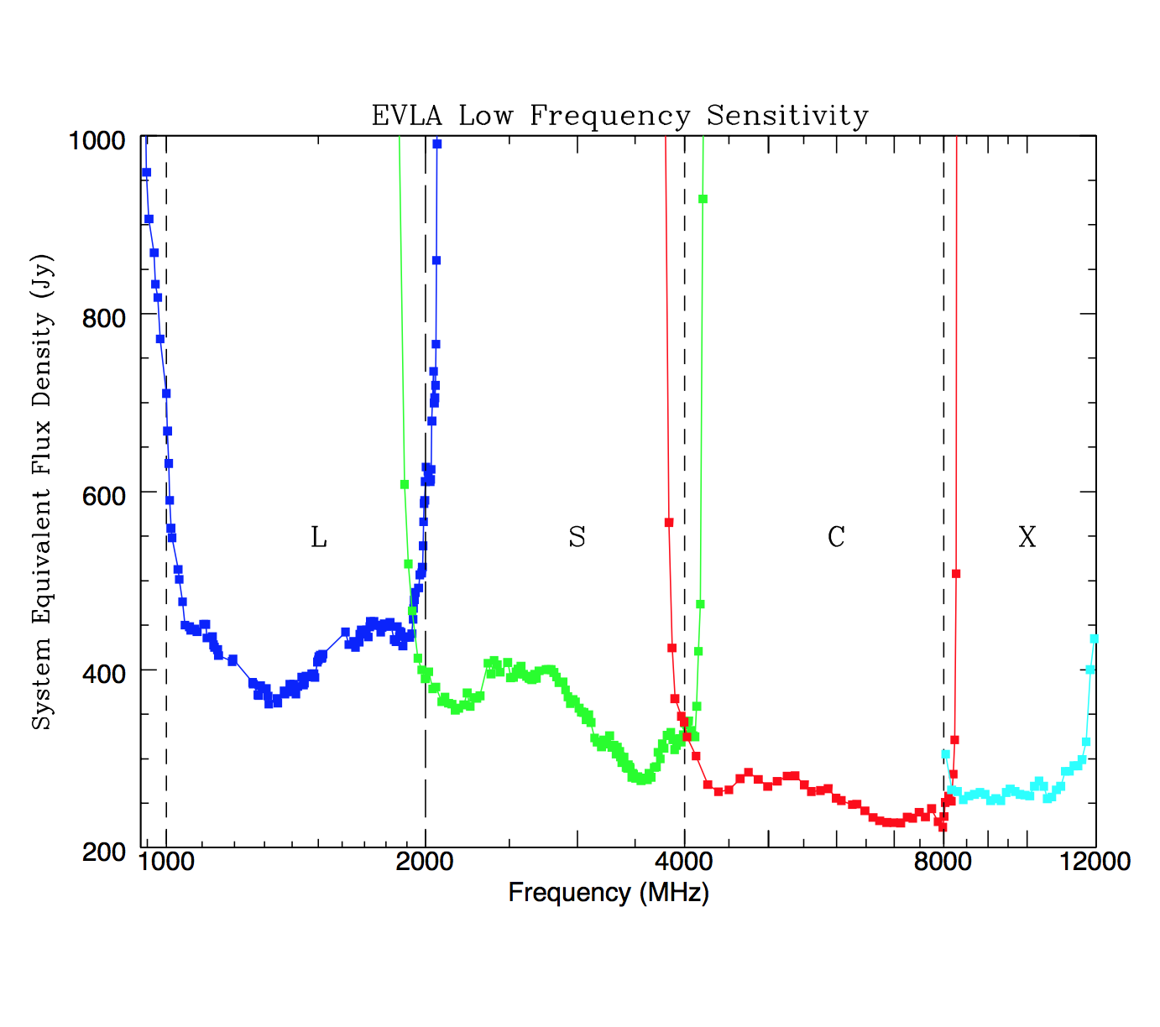
Collecting Radio Light
Sensitivity (EVLA)

Slide 37
Collecting Radio Light
Photon Rate
Specific Flux of 3C273 ~ 100 Jy at 1 GHz
For a bandwidth of 100MHz, I calculate
15,000 photons pass through 1 cm² / s
This ought to be duck soup!!

Slide 38
Collecting Radio Light
To be continued...

Slide 39
Interferometry
Telescope Angular Resolution = λ/D radians
Telescope Angular Resolution = 0.2 * λ(in microns) /D (in meters) arcseconds
Question:
-What is the resolution of Keck (10 meters) at H-band (1.65 microns)?
-What is the resolution of Keck (10 meters) at ALMA Band 3 (3.0 millimeters)?

Slide 40
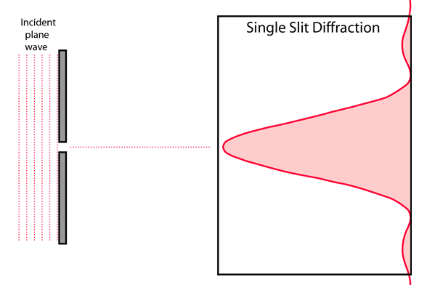
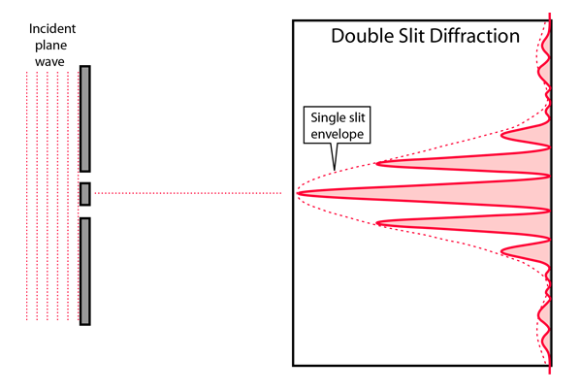
Interferometry

Slide 41
Interferometry
D=Diameter of 1 Telescope
B=Baseline i.e. separation between telescopes
λ/D
λ/2B

Slide 42
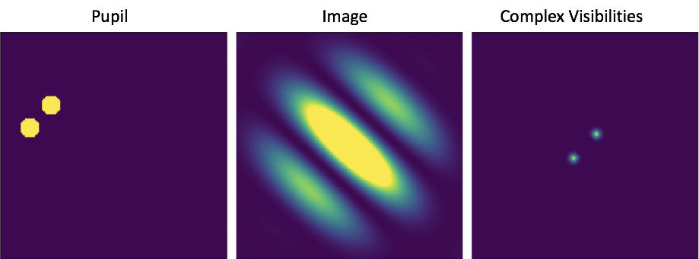

Slide 43
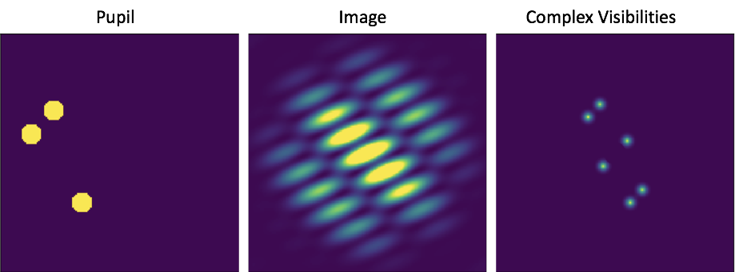

Slide 44
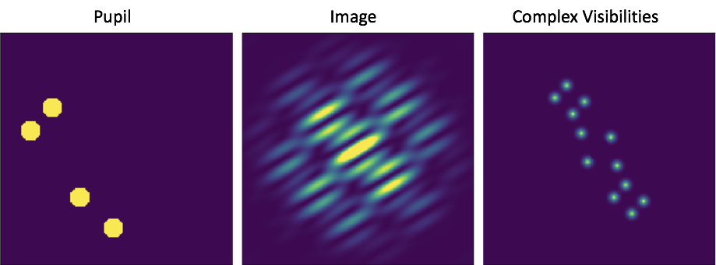

Slide 45
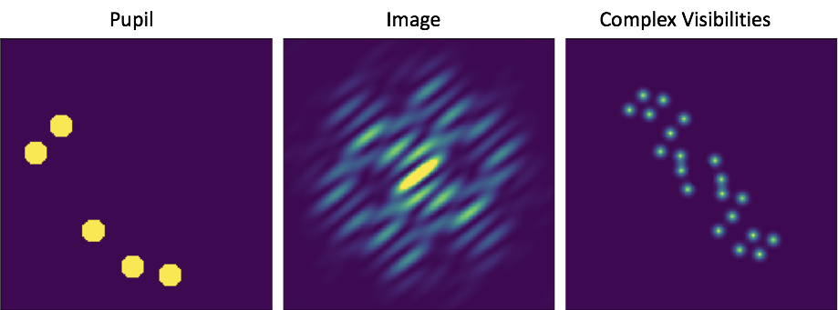

Slide 46
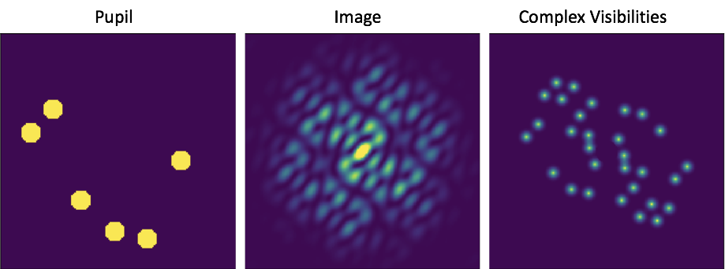

Slide 47
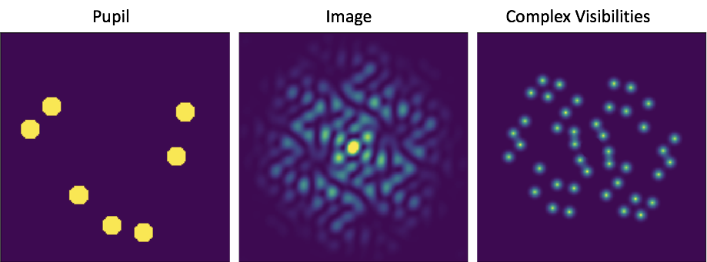

Slide 48
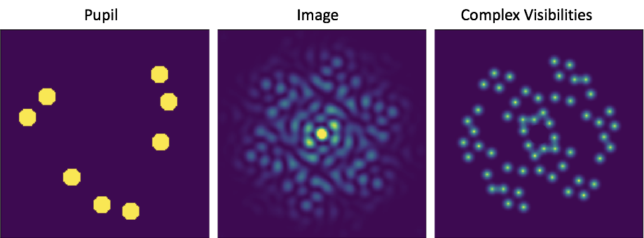

Slide 49
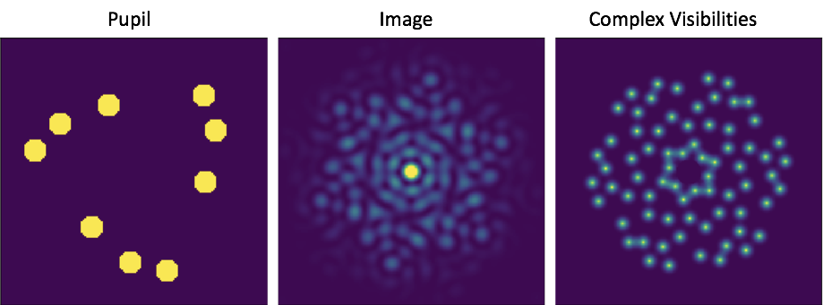

Slide 50
Resolution matches the resolution of a filled aperture telescope (albeit with a weirder point-spread-function and less collecting area).

Slide 51
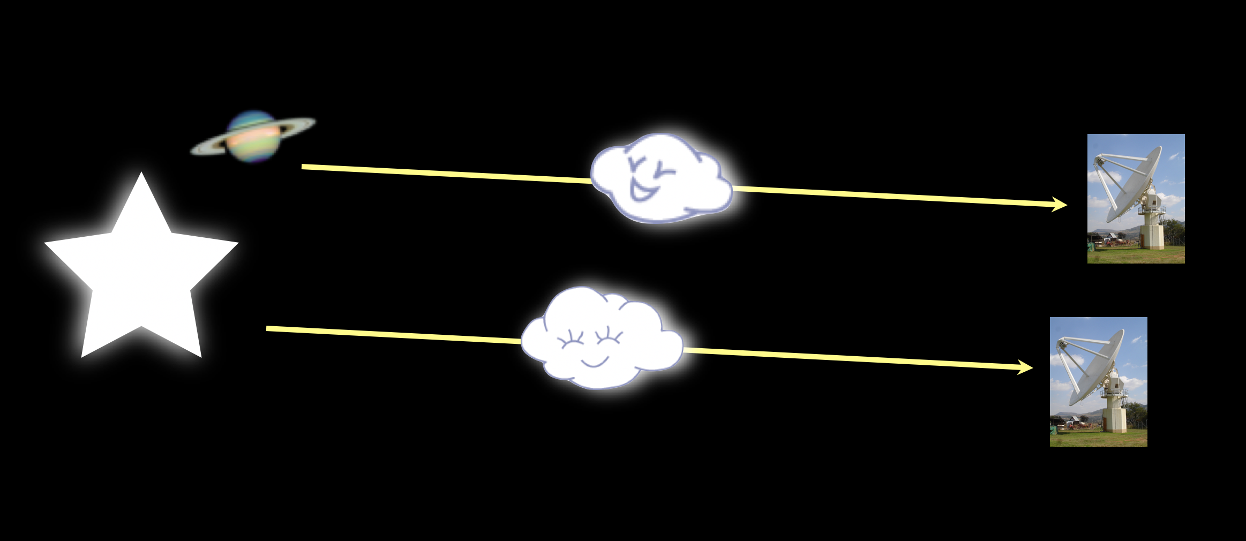
The Earth’s Atmosphere
Water vapor slows down light. Light arrives out of phase at different telescopes. This impacts visible a lot. Radio has longer wavelengths, so less of a fractional effect.

Slide 52
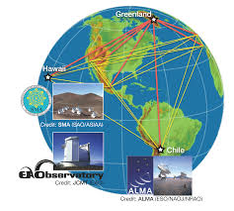
Very Long Baseline Interferometer

Slide 53
